Slide 1

STOCK MARKET
Mariah Bastos
Rene Villarreal
Xiomara Chirinos
CIS-544 DATA MINING & MACHINE LRNG

Slide 2
OUTLINE
Competition
Approaches
Challenges
Impressions
Code
Models
Overall Approach
Models
Iterations
Metrics
Comparison & Ranking
Code

Slide 3

COMPETITION

Slide 4
Overview
The purpose of this project was to create a day-trading algorithm in the IEX market given a specific set of instructions and restrictions. Each team member was given $100,000 and had the following restrictions in order to avoid penalties:
Trading must be done automatically from an EC2 instance.
Can only do two transactions per minute.
At least 250 successful trades per day.
Maximum of 500 successful trades per day.
Trading hours are 9:30AM EST to 4:00PM EST.
Only ten trades per symbol per day.
Uninvested cash is wiped at the end of each trading day.
The penalties for having less than 250 transactions were $100 per missed transaction, and the penalties for failed transactions were $1,000 each.
Two APIs were used in our codes: an API for accessing big data for all, and an API for accessing Tiingo.

Slide 5
Approaches
Exponential Moving Average
The first model we used was an exponential moving average. We created two moving averages, a shorter time period (30 minutes) and a longer time period (90 minutes). Our approach using this model was simple: whenever the shorter moving average crossed the longer moving average going up, we would generate a sell signal. When the shorter moving average crossed the longer moving average going down, we would generate a buy signal. This approach is widely used in long-term trading, as it tends to show trends and when a market is bearish or bullish. In day-trading, the rules are reversed because the moving averages move very closely with the real time data. So in a long-term trading when a shorter average crosses the longer average, it tends to mean that the stock is bullish and we should buy. In day trading, it means the stock is at a higher price than when you last bought it so we would sell instead of buy.

Slide 6
Approaches
Simple Moving Average
Similar to the one above, it generates the same signals when a shorter moving average crosses the longer moving average. The main difference between these two approaches is that the simple moving averages weighs all data points the same, while an exponential moving average gives more weight to more recent data points.

Slide 7
Approaches
Scalping
This is a common approach to day-trading. The main purpose of this model is to generate small profits whenever the stock rises above the buying price. Generally, the profits are not big, but the idea is that with the sum of small profits you can eventually make enough. This model carries lower risk than the exponential moving average and the simple moving average because it is strictly based on the price of the stock at the moment, and not it's history.

Slide 8
Challenges
What challenges did you face in the bot creation? Were there any major pivots?
Challenges while creating the bot:
Limitations
EC2 instance libraries
Market hours for testing
Tiingo API call limit
Challenges after bot implementation:
Remaining budget (purchasing last stock)
2 calls per minute
Keeping track of transactions
Notes:
Limitations: when looking through the instructions and all the limitations we had, like only 2 calls per minute, no more than 10 of the same stock per day, etc… we realized that when we coded and solved one exception, more appeared in the process flow. For example: when the model generated a sell signal, we knew we had to sell only if we had the stock. So we coded the rule so that we only sold if the stock was in our transaction list. But then we realized we had to check if we had less than 10 trades of that stock in the day, so we coded around that and we realized that even if it meet the 10 trade limit we had to make sure that the budget was sufficient. Another example was when we generated the signals for each minute, it was simple when there were only two signals in a given minute. but if there were more than two, which two should we pick? two buys? two sells? or one of each? because if we ignored the “buy” signals, the next time the model generated a signal for that stock it would be a sell, but we would not have that stock in our portfolio because we never bought it on the last signal.
EC2 instance libraries: we had issues installing tidyverse on our EC2 instance, and Mariah and Xiomara both had to create a new EC2 with new .pem keys. One of the EC2 instance crashed and got deleted.
We started developing our models a little later than we should have, so by the time we had a functioning bot we could not test it live. Luckily, the first day that the competition was supposed to start was given to everyone as an additional test day.
We had to purchase the tiingo membership for a month because we kept running into the 500 calls per hour issue with tiingo basic membership while testing. We paid the $10 and the limit was upgraded to 20,000 calls per minute.
After the stock implementation we had an issue the first day with the remaining budget. We coded our bot so that from 3:30 to 3:59pm it looked at our current budget and buy sufficient ADT stocks to leave us with the least amount of cash possible. When we coded it we used if budget > 0, divide it by the price of the ADT stock and buy the integer value. so if the value was 4.9, it would buy 4, and the loop would theoretically continue until it had $0. However, we noticed that when it did the division and the value was 0.4, it tried to buy 0 stocks and it would generate an error. So the next day we fixed it to only buy ADT stock while the budget > 20 (the stock was averaging about $9-$10).
The second day, once we had stocks in our portfolio, we ran into problems with the 2 calls per minute. We did not code it properly the first time and realized our nested ifs were treating 3 calls per minute as being 2 calls and it tried to generate three transactions in one minute.
Our third problem after the implementation was keeping track of our transactions. Ultimately we settled for the log, even though it was not ideal but our models worked based off of that so we did not edit it.

Slide 9
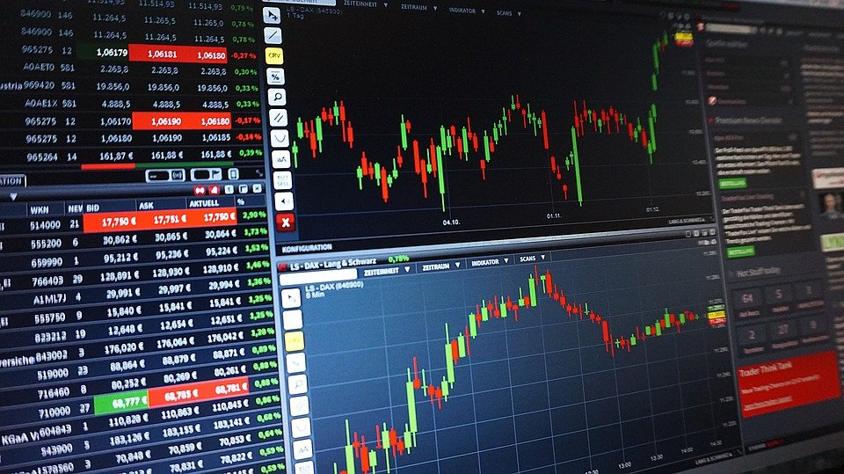
IMPRESSIONS ON HIGH FREQUENCY ALGOTRADING
Notes:
high frequency trading and algotrading are very risky and time consuming. I do not think that i would ever trust a model to automatically trade my real money no matter how confident i am in it. Deploying bots on AWS is an interesting concept because we can leave our machine running in the background and not interfere with our computer space and memory.

Slide 10

CODE AND EXPLANATION
Notes:
high frequency trading and algotrading are very risky and time consuming. I do not think that i would ever trust a model to automatically trade my real money no matter how confident i am in it. Deploying bots on AWS is an interesting concept because we can leave our machine running in the background and not interfere with our computer space and memory.

Slide 11
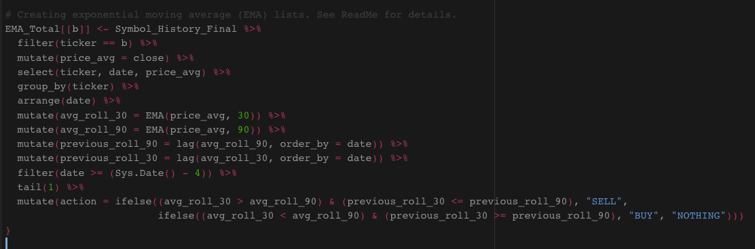
Exponential Moving Average

Slide 12
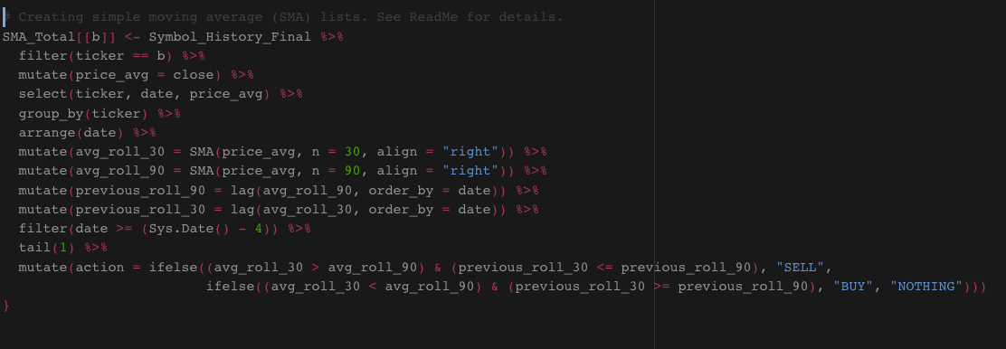
Simple Moving Average

Slide 13
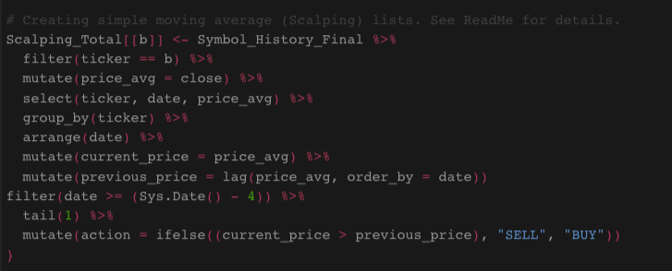
Scalping

Slide 14

MODELS

Slide 15
Overall Approach
The six models were all fed historical data by minute from October 1, 2020 to December 31, 2020.
We set the test/validation period from January 1, 2021 to February 26, 2021.
This project gave us exposure applying machine learning models learned in the classroom to real-world situations like the stock market.

Slide 16
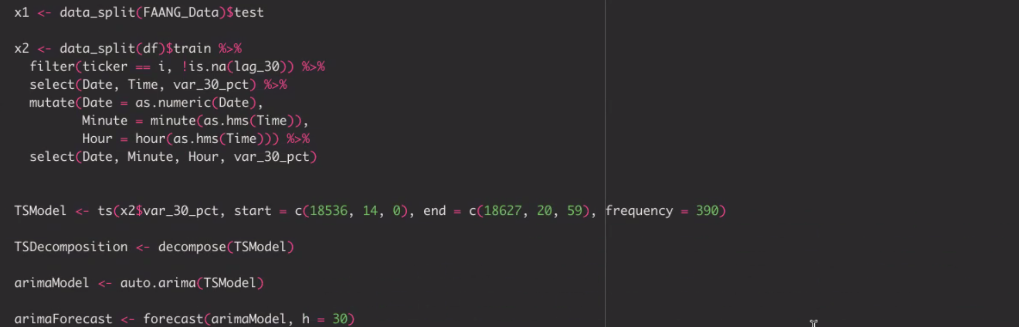
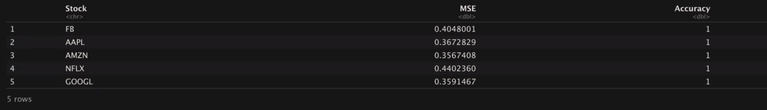
Time Series

Slide 17
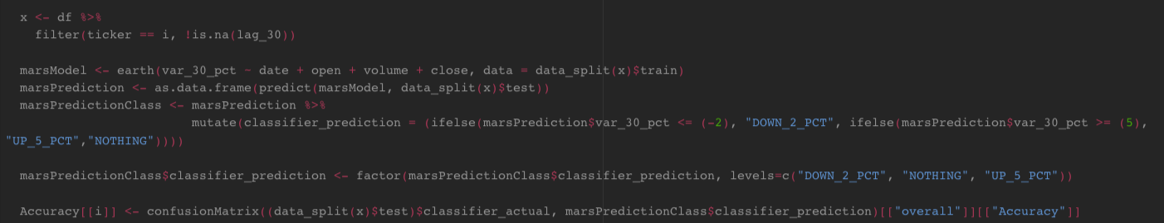
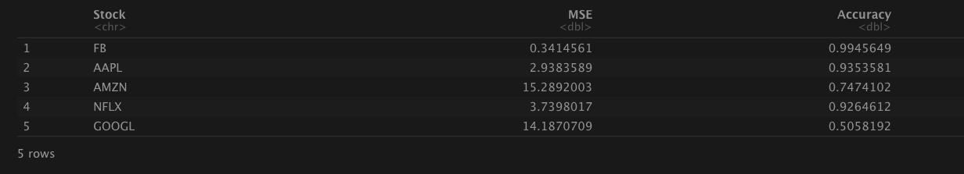
MARS

Slide 18
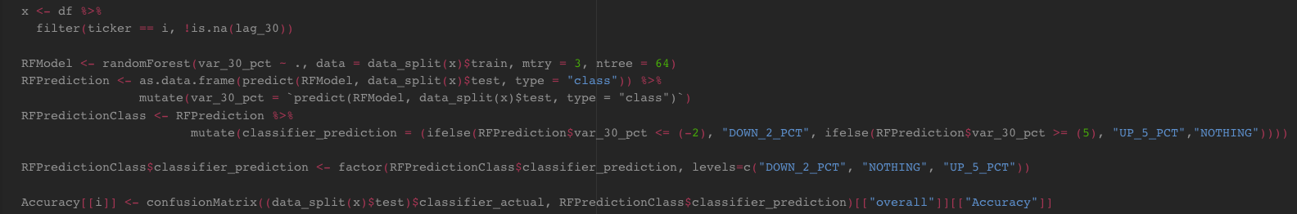
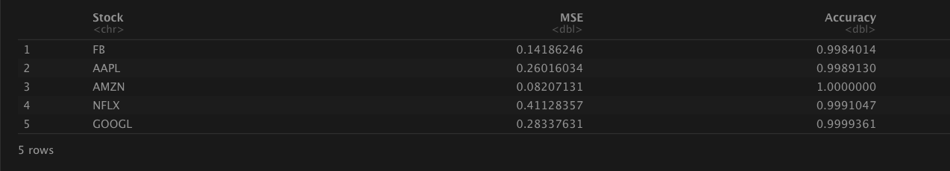
Random Forest

Slide 19
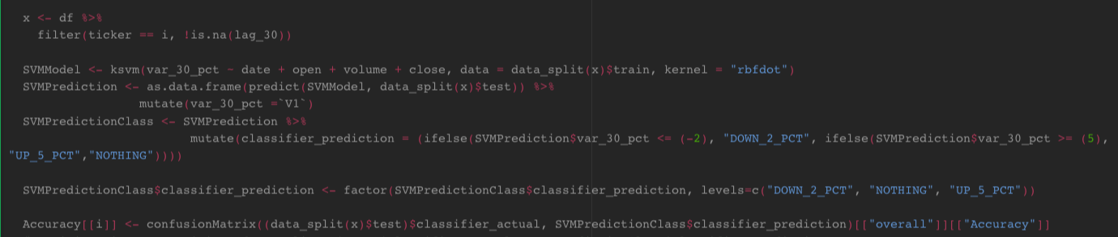
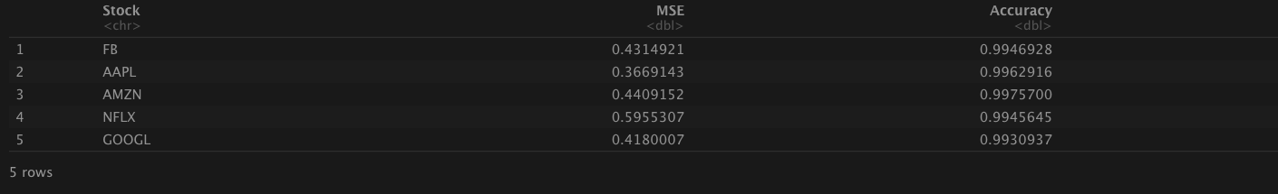
SVM

Slide 20
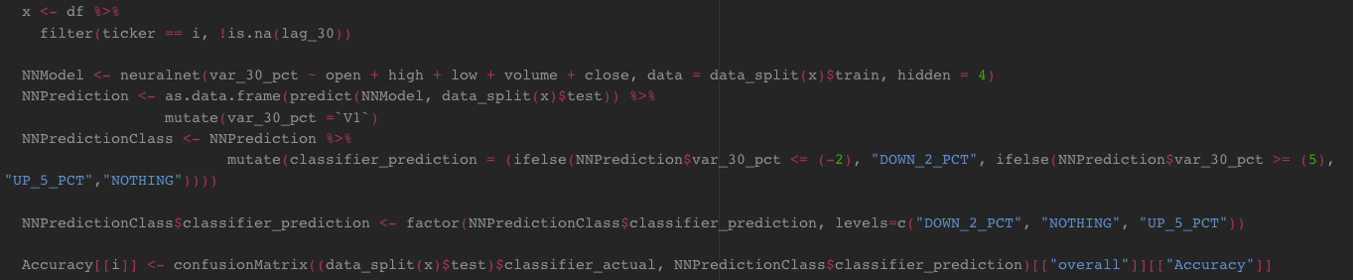
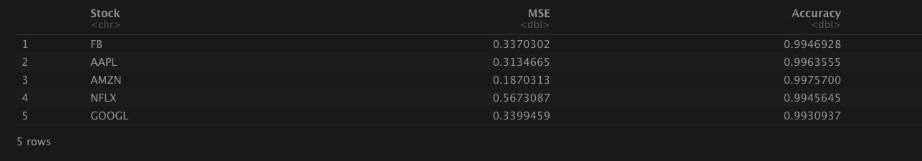
Deep Learning

Slide 21
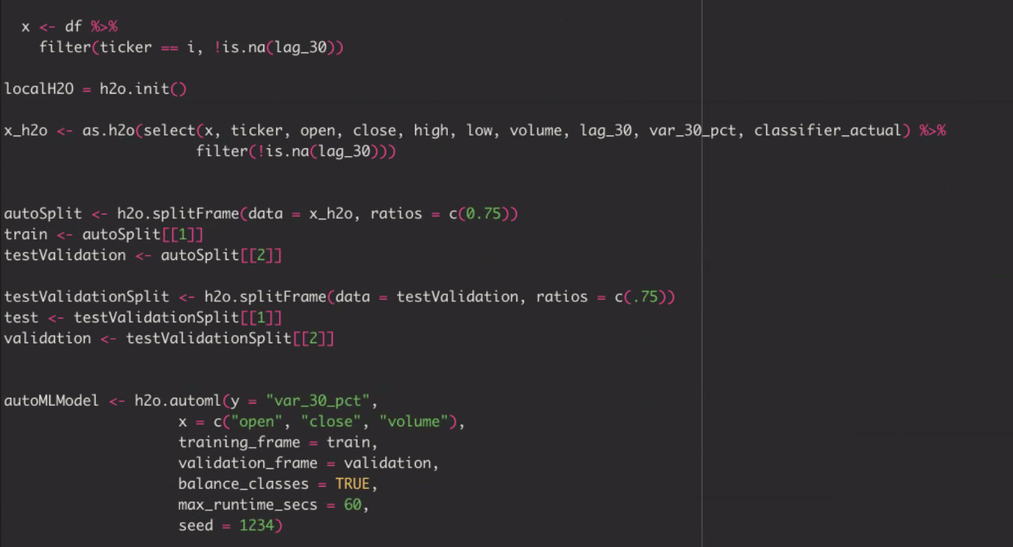
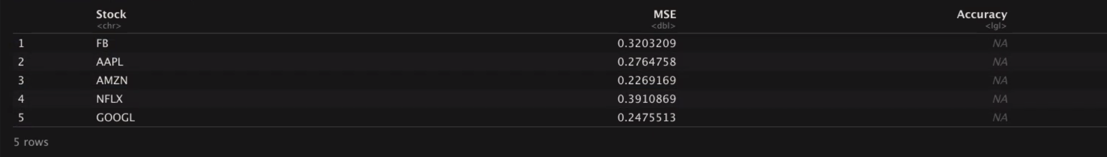
AutoML

Slide 22
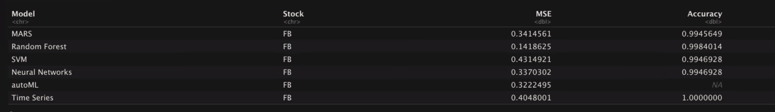
Model Results - Facebook
For Facebook, Random Forest had the lowest MSE.
While Time Series had an accuracy of 100%, we believe there is something wrong with the model because it produced the same result for all the stocks

Slide 23
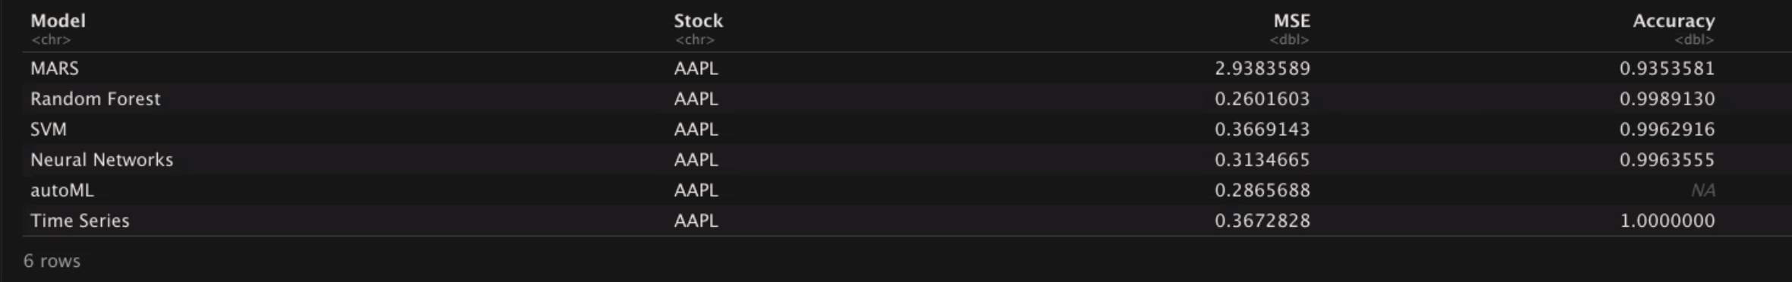
Model Results - Apple
For Apple, Random Forest had the lowest MSE and also the highest Accuracy.

Slide 24
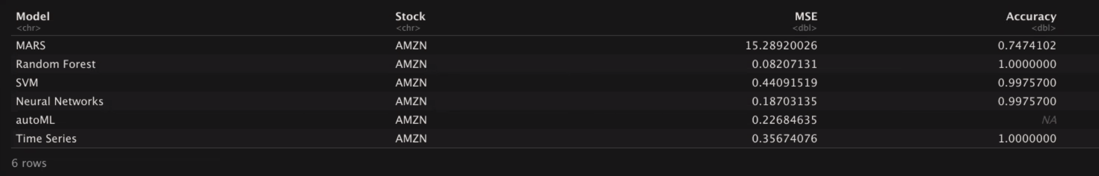
Model Results - Amazon
For Amazon, Random Forest had the lowest MSE and also the highest Accuracy.

Slide 25
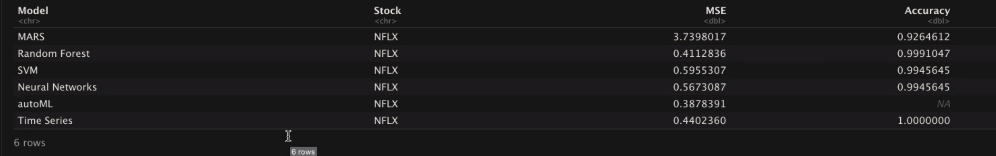
Model Results - Netflix
For Netflix, autoML had the lowest MSE, but Random Forest had the highest accuracy. Further on we will see if the MSE is significantly different from one model to the other.

Slide 26
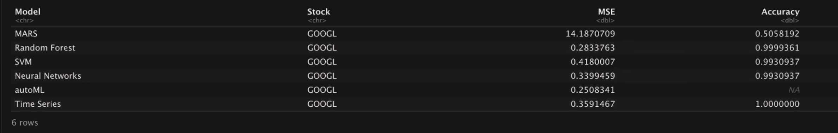
Model Results - Google
For Google, like Netflix, autoML had the lowest MSE, but Random Forest had the highest accuracy. Further on we will see if the MSE is significantly different from one model to the other.

Slide 27
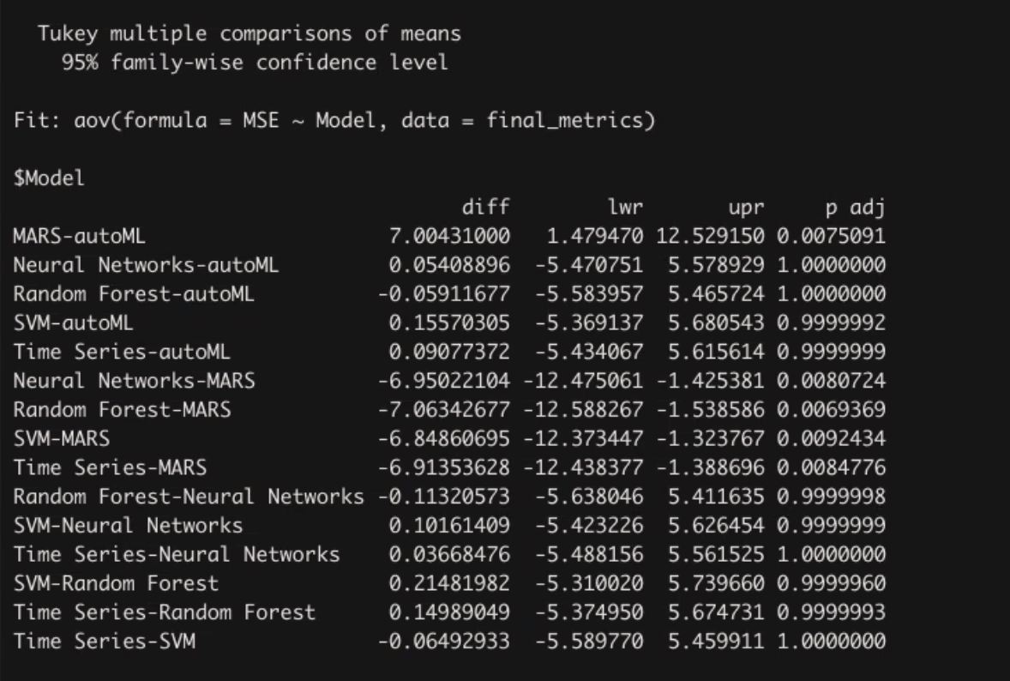
MSE Significant Difference
Using alpha of 0.05, we can conclude that there is only significant difference in the MSE’s between MARS and any other model because their p-values are less than 0.05

Slide 28
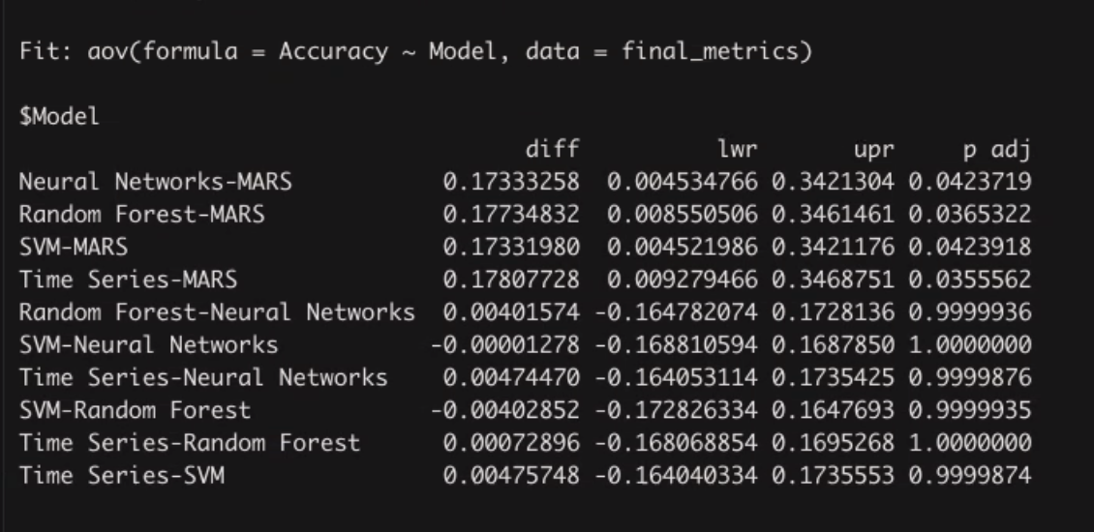
Accuracy Significant Difference
Using alpha of 0.05, we can conclude that there is only significant difference in the Accuracies between MARS and any other model because their p-values are less than 0.05

Slide 29

CODE EXAMPLE
Notes:
high frequency trading and algotrading are very risky and time consuming. I do not think that i would ever trust a model to automatically trade my real money no matter how confident i am in it. Deploying bots on AWS is an interesting concept because we can leave our machine running in the background and not interfere with our computer space and memory.

Slide 30
QUESTIONS?

Slide 31
THANK YOU

